Slide 1



Noida Institute of Engineering and Technology, Greater Noida
Blockchain Ethereum
UNIT 4
Unit: 4
BLOCKCHAIN TECHNOLOGY AND
APPLICATION DEVELOPMENT (ACSAI0601)
Mr. Yaduvir Singh
Assistant Professor
B.Tech AI
Course Details (B Tech 6th Sem)

Slide 2

Noida Institute of Engineering and Technology, Greater Noida
YADUVIR SINGH
BE and M.Tech in CSE with 15 Years Teaching Experience
Area of Expertise:AI ,Data Science,Block Chain
Membership:MISTE(lifetime),MIAENG,MIFERP,MCSTA ,MIRED.
Received Best Faculty Award in SIET Ghaziabad in October 2008.
Act as an External Judge for the 25th National Children Science Congress a Program by DST India at Kendriya Vidyalaya Greater Noida From 23 to 25 October 2017.
Attended and Conducted Numerous National Level Workshops.
Published about 20 National and International Papers in reputed Journals.
Going to finish my MSWC(Master of Social Work in Counselling)through IGNOU by 2021.

Slide 3

Noida Institute of Engineering and Technology, Greater Noida

Slide 4
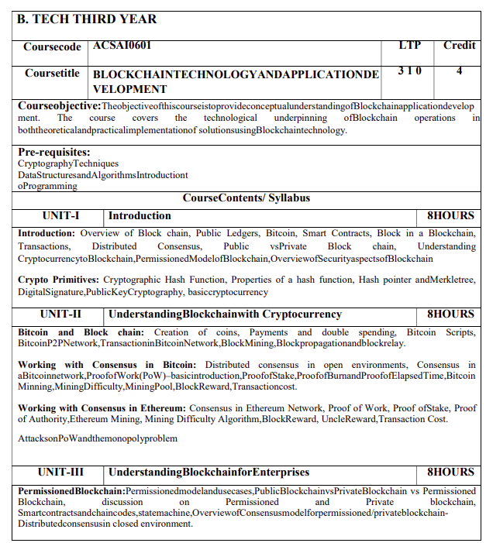
Noida Institute of Engineering and Technology, Greater Noida
Syllabus

Slide 5
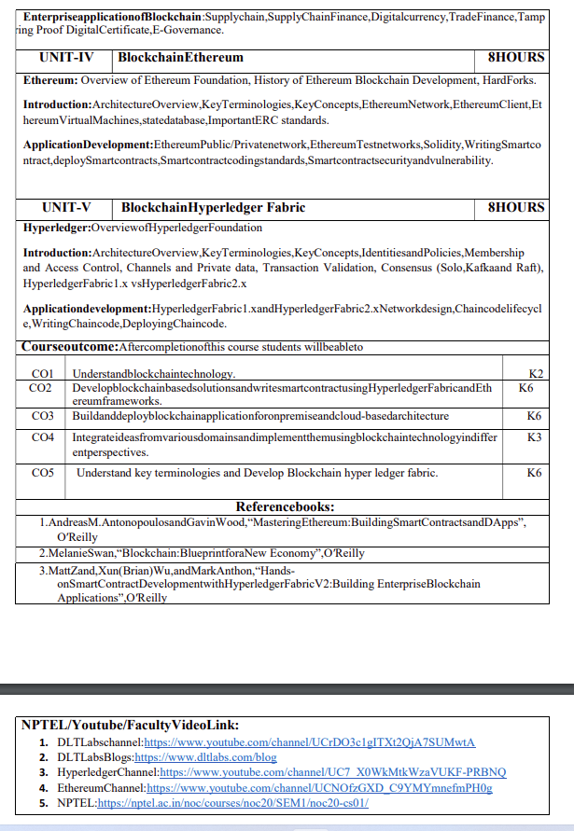
Noida Institute of Engineering and Technology, Greater Noida
Syllabus

Slide 6
Branch Wise Applications
It can compute man-made problems as well as natural phenomena. Block Chain theory has a lot of applications in real life as well, such that in SCM,education ,security ,banking and many fields.

Slide 7

Course Objective
To assess blockchain applications in a structured manner.
To impart knowledge in block chain techniques and able to present the concepts clearly and structured.
To get familiarity with future currencies and to create own crypto token.

Slide 8
Course Outcome
Course Outcome (CO) |  | Bloom’s Knowledge Level (KL)
At the end of the course, the student will be able to understand
CO 1 | Understand block chain technology. |  | K2
CO 2 | Develop block chain based solutions and write smart contract using Hyper ledger Fabric and Ethereum frameworks. |  | K6
CO 3 | Buildanddeployblockchainapplicationforonpremiseandcloud-basedarchitecture |  | K6
CO 4 | Integrate ideas from various domains and implement them using block chain technology in differ ent perspectives. |  | K3
CO 5 | Understand key terminologies and Develop Block chain hyper ledger fabric. |  | K6

Slide 9
Program Outcomes
Engineering Graduates will be able to Understand:
1. Engineering knowledge
2. Problem analysis
3. Design/development of solutions
4. Conduct investigations of complex
5. Modern tool usage
6. The engineer and society
7. Environment and sustainability
8. Ethics
9. Individual and team work
10. Communication
11. Project management and finance
12. Life-long learning

Slide 10
CO-PO and PSO Mapping
CO-PO correlation matrix of Block Chain and Application Development(ACSAI0601)
 | PO1 | PO2 | PO3 | PO4 | PO5 | PO6 | PO7 | PO8 | PO9 | PO10 | PO11 | PO12
ACSAI0601 | 2 | 2 | 3 | 3 | 2 | 2 | - | - | 2 | 1 | - | 3
ACSAI0601 | 1 | 3 | 2 | 3 | 2 | 2 | - | 1 | 1 | 1 | 2 | 2
ACSAI0601 | 2 | 2 | 3 | 2 | 2 | 2 | - | 2 | 2 | 1 | 2 | 3
ACSAI0601 | 2 | 2 | 2 | 3 | 2 | 2 | - | 2 | 2 | 1 | 1 | 3
ACSAI0601 | 3 | 2 | 2 | 2 | 2 | 2 | - | 2 | 1 | 1 | 1 | 2
Average | 2 | 2.2 | 2.4 | 2.6 | 2 | 2 | - | 1.4 | 1.6 | 1 | 1.2 | 2.6
Mapping of Program Specific Outcomes and Course Outcomes:

Slide 11
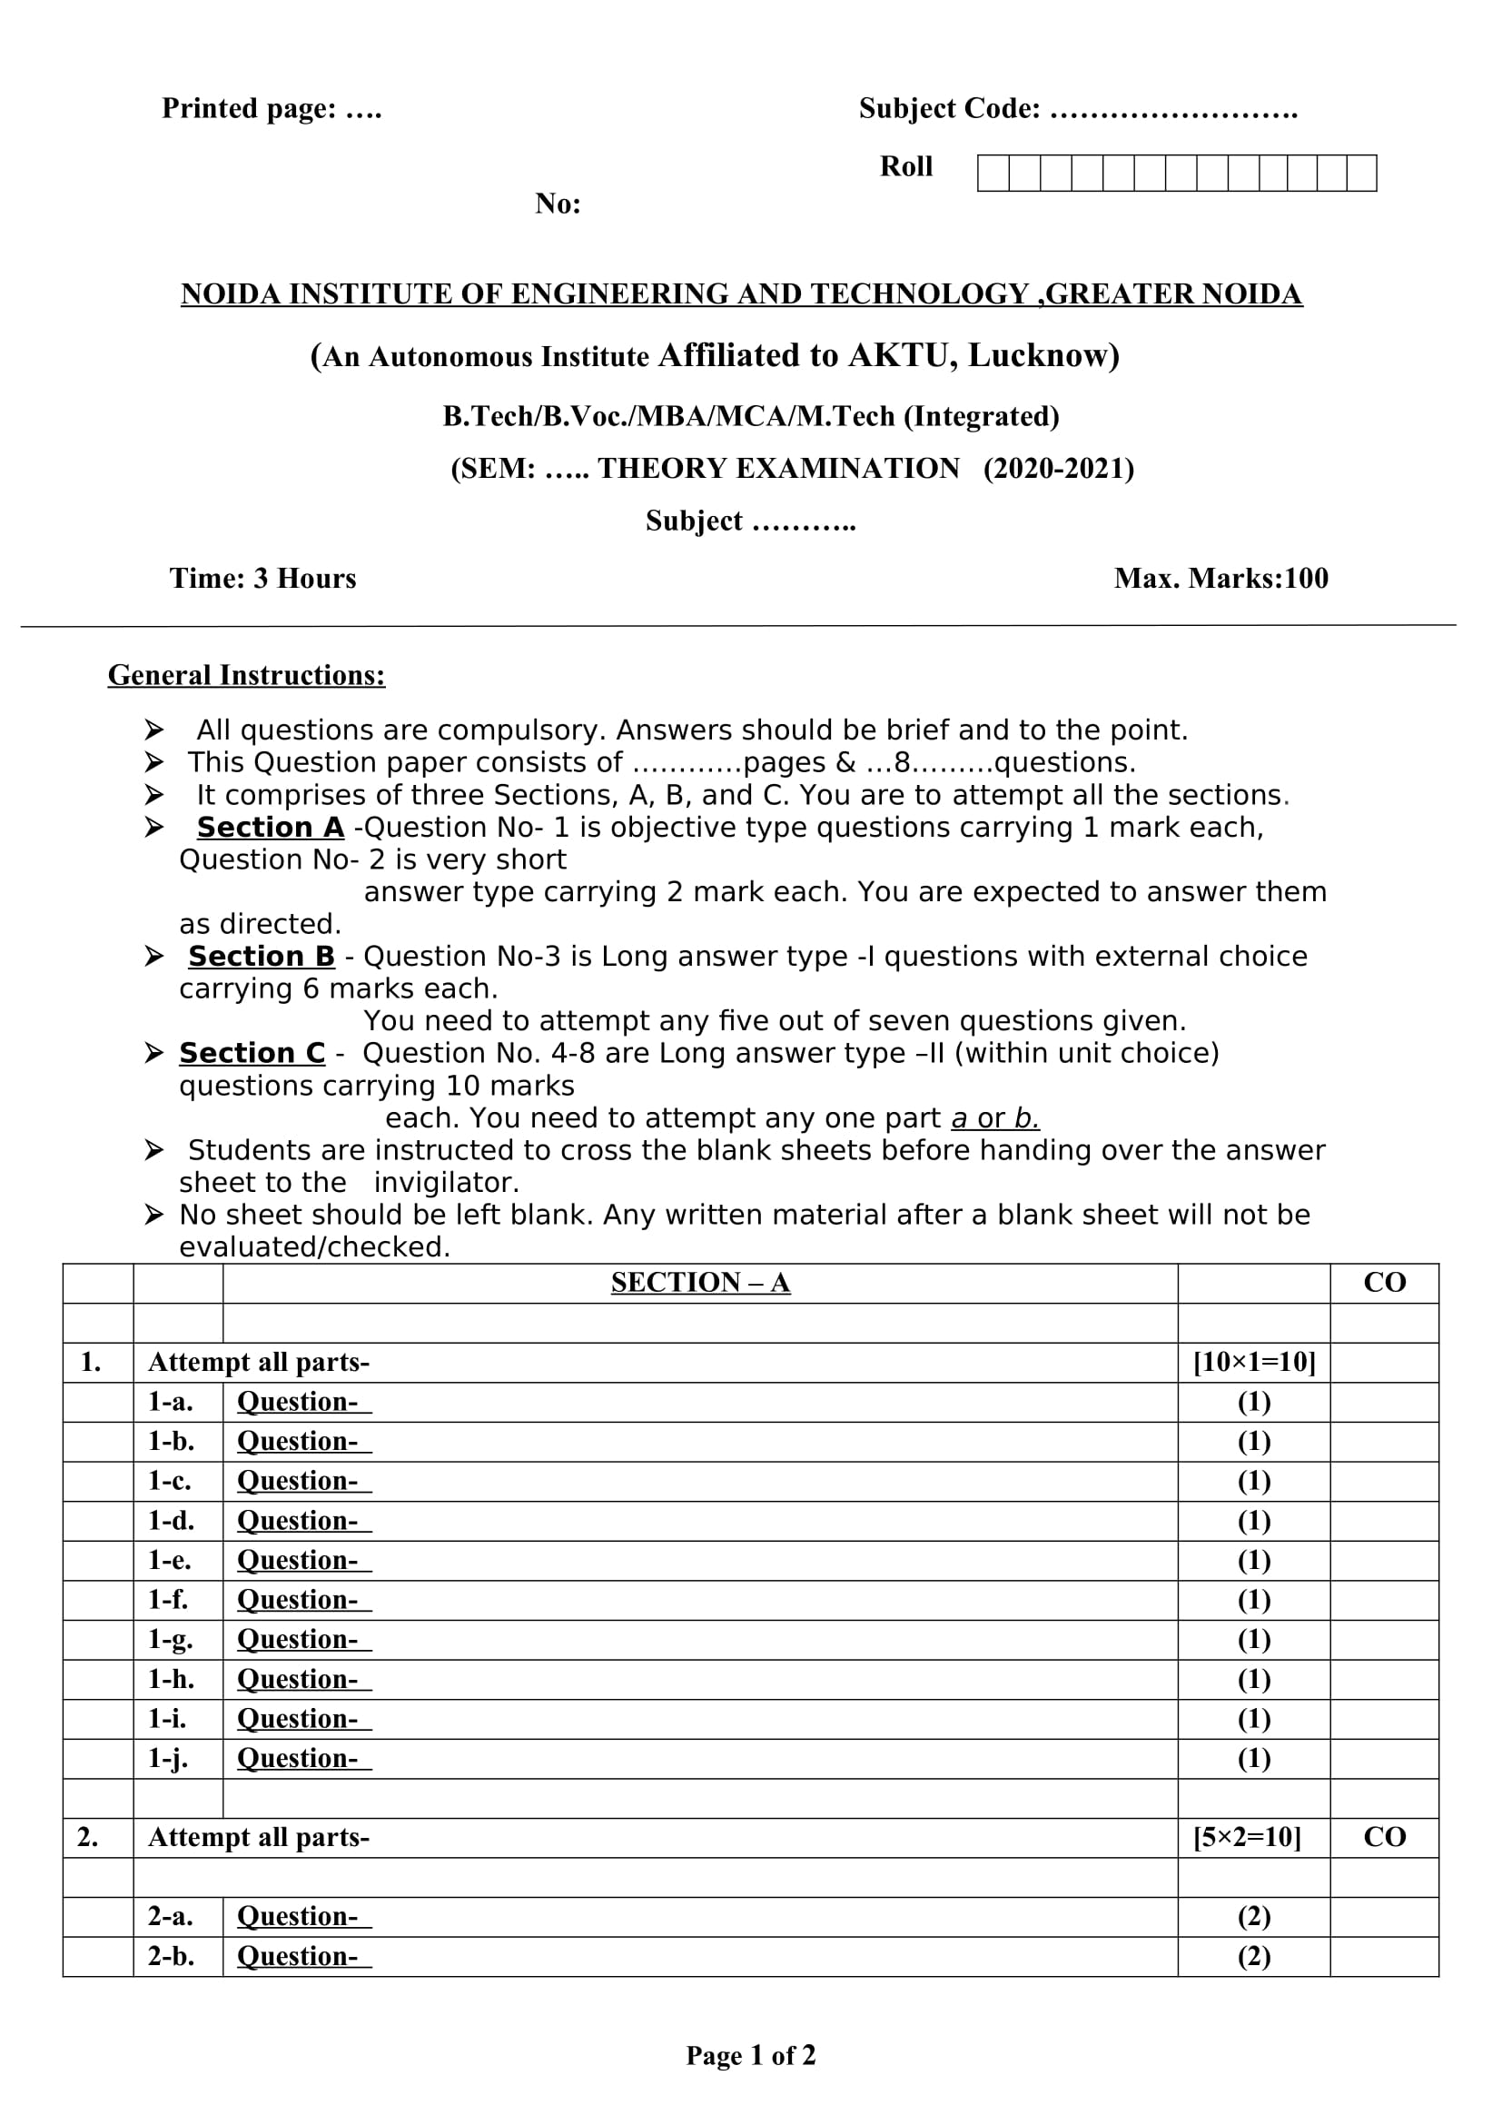
End Semester Question Paper Templates (Offline Pattern/Online Pattern)
End Semester Question Paper Templates (Offline Pattern/Online Pattern)

Slide 12
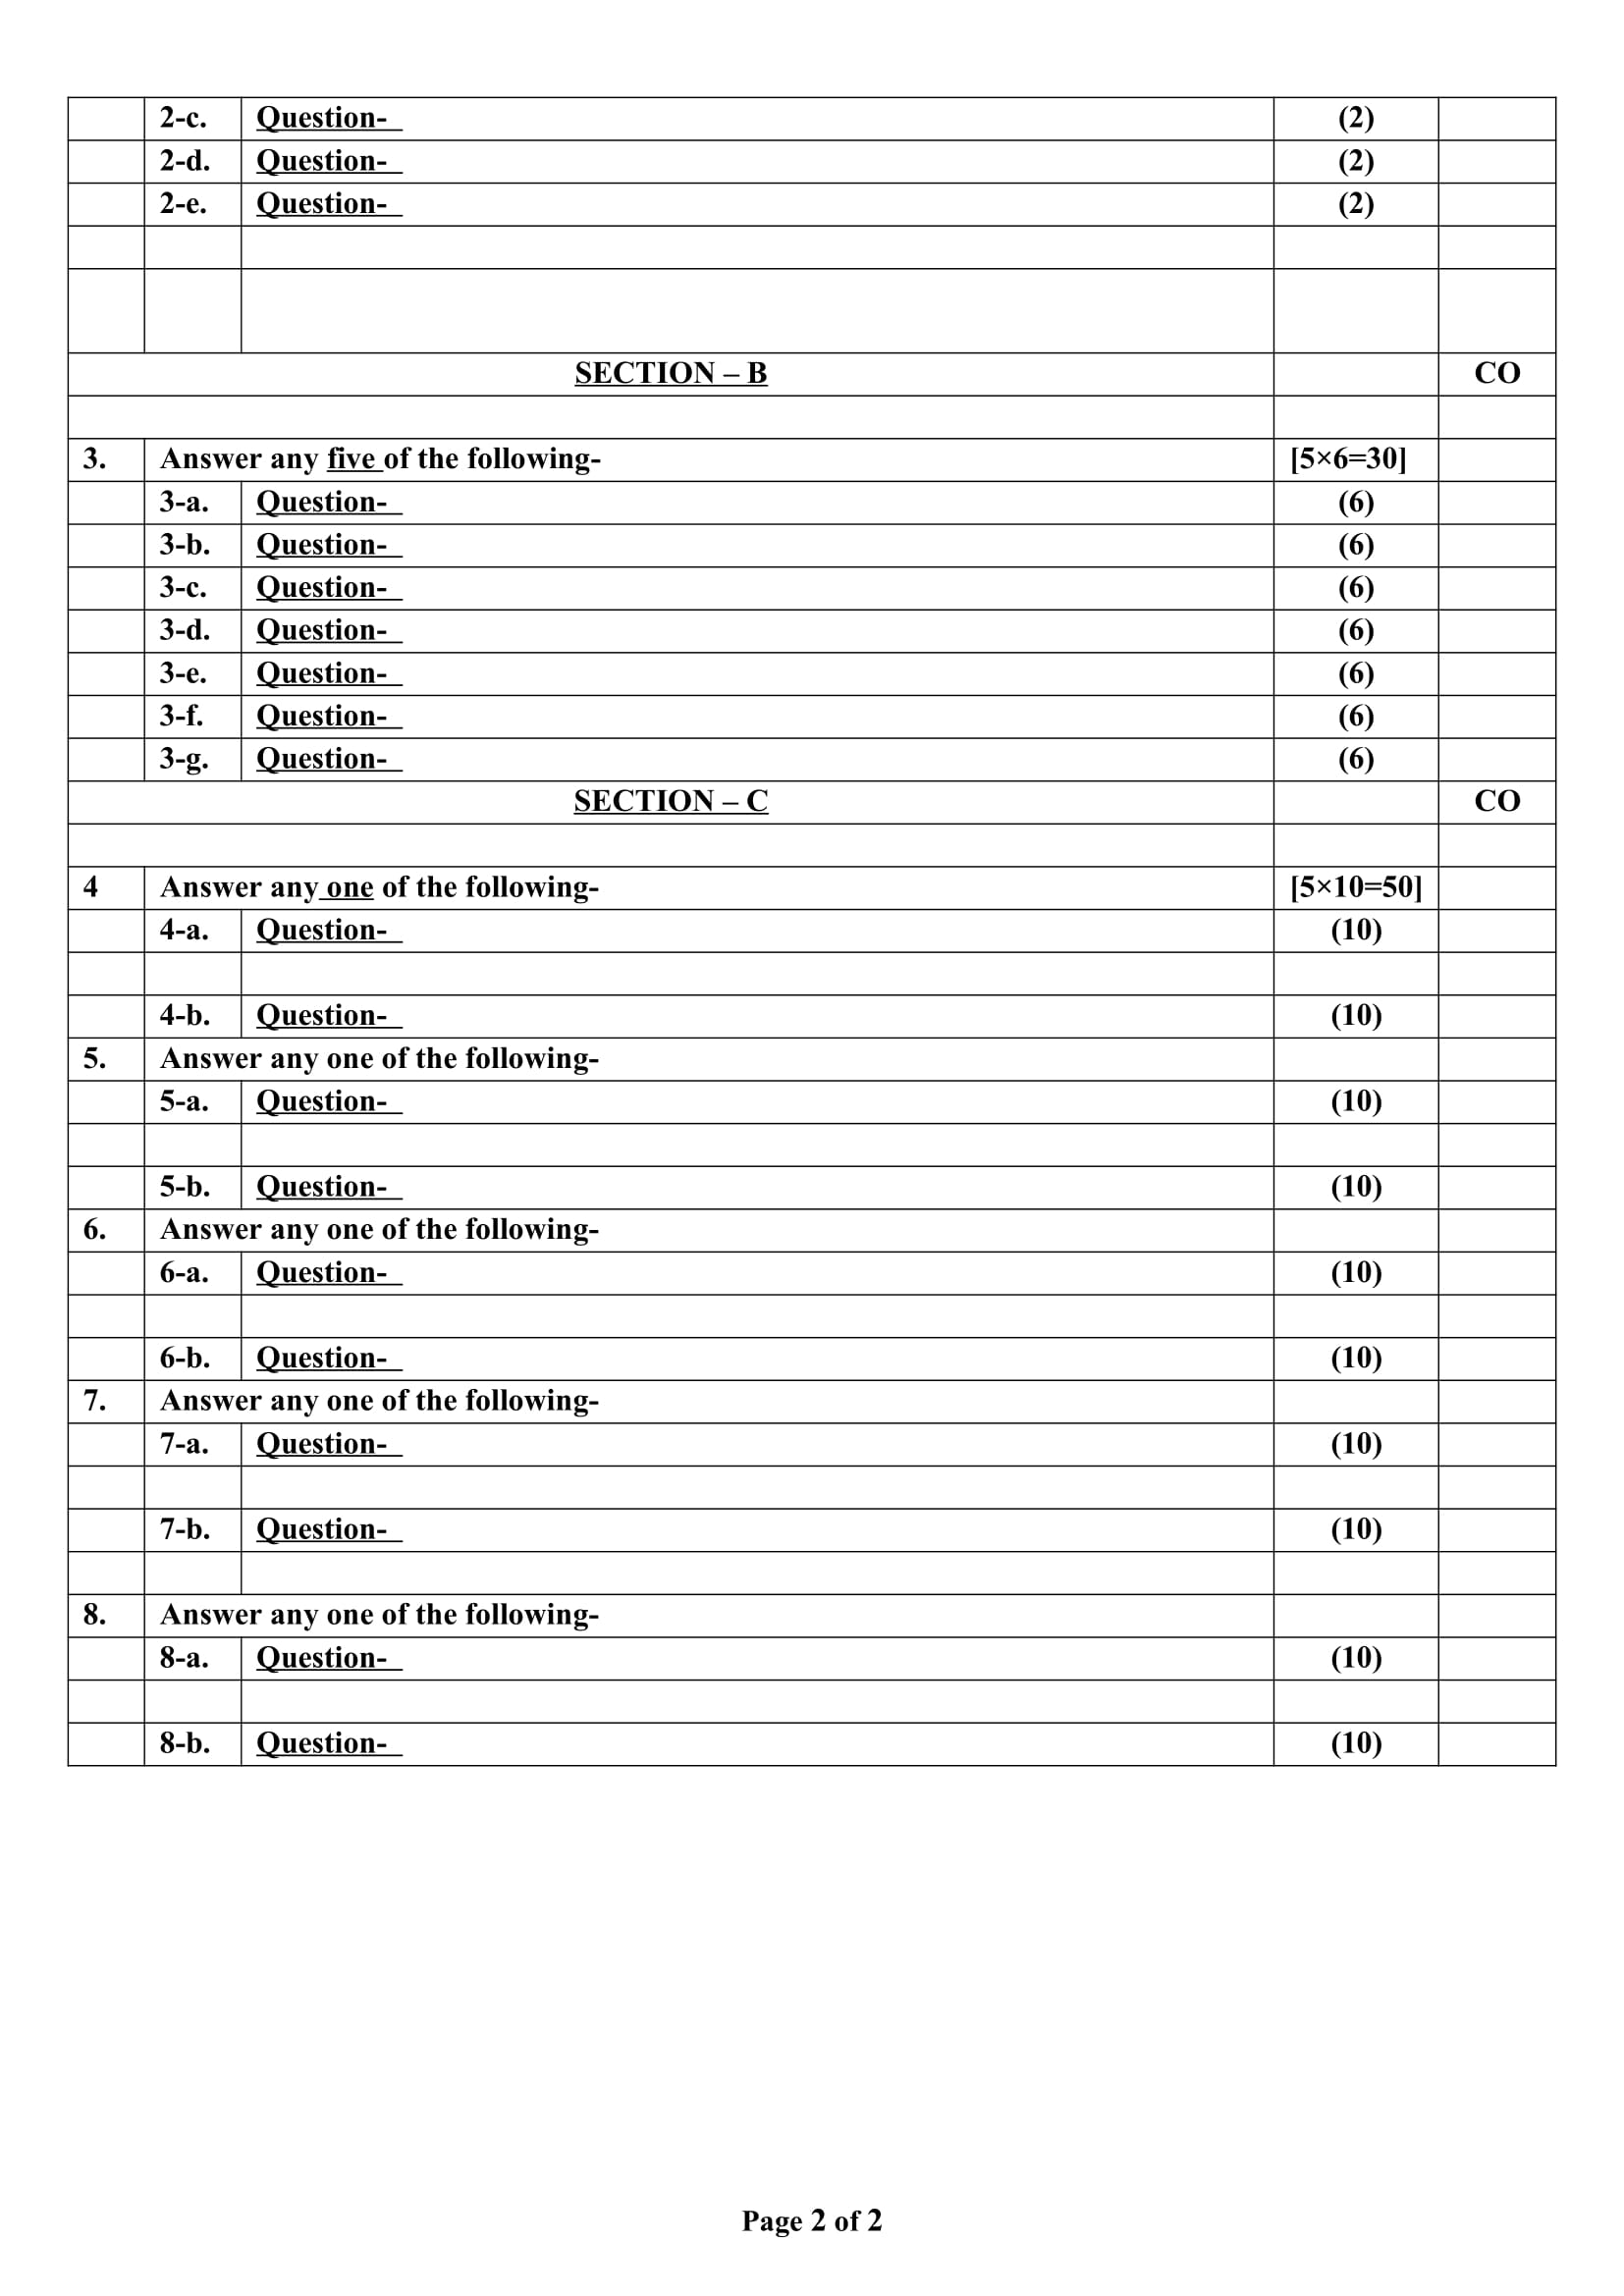
End Semester Question Paper Templates (Offline Pattern/Online Pattern)

Slide 13
Prerequisite and Recap
Brief input about the block chain and its introduction in the different fields. The basics of the Cyber security and cryptography are the requirements of this course.

Slide 14
Brief Introduction about the Subject with videos
Blockchain is a buzzword in today’s technology and this technology is described as the most disruptive technology of the decade.
Thus, Blockchain is used for the secure transference of items like money, contracts, property rights, stocks, and even networks without any requirement of Third Party Intermediaries like Governments, banks, etc.
DLTLabschannel:https://www.youtube.com/channel/UCrDO3c1gITXt2QjA7SUMwtA
DLTLabsBlogs:https://www.dltlabs.com/blog
HyperledgerChannel:https://www.youtube.com/channel/UC7_X0WkMtkWzaVUKF-PRBNQ
EthereumChannel:https://www.youtube.com/channel/UCNOfzGXD_C9YMYmnefmPH0g
NPTEL:https://nptel.ac.in/noc/courses/noc20/SEM1/noc20-cs01/

Slide 15
Content
Overview of Ethereum
History of Ethereum
Hard Fork
Architecture of Ethereum
Ethereum Network
Ethereum Virtual Machines
Application Development of Ethereum

Slide 16
Topic Objectives
The objective of this topic is to provide
conceptual understanding of Ethereum
working of Ethereum
Application of Ethereum

Slide 17
Unit IV Syllabus
Ethereum: Overview of Ethereum Foundation, History of Ethereum Blockchain Development, HardForks. Introduction:ArchitectureOverview,KeyTerminologies,KeyConcepts,EthereumNetwork, Ethereum Client, Ethereum Virtual Machines, state database, Important ERC standards. Application Development:
Ethereum Public/Private network, Ethereum Test networks, Solidity, Writing Smart contract, deploy Smart contracts, Smart contract coding standards, Smart contract security and vulnerability.

Slide 18
Overview of Ethereum(CO4)
Ethereum is a decentralized blockchain platform that establishes a peer-to-peer network that securely executes and verifies application code, called smart contracts.
Smart contracts allow participants to transact with each other without a trusted central authority.

Slide 19
Overview of Ethereum (CO4)
Ethereum Features
Ether: This is Ethereum’s cryptocurrency.
Smart contracts: Ethereum allows the development and deployment of these types of contracts.
Ethereum Virtual Machine: Ethereum provides the underlying technology—the architecture and the software—that understands smart contracts and allows you to interact with it.
Decentralized applications (Dapps): A decentralized application is called a Dapp (also spelled DAPP, App, or DApp) for short. Ethereum allows you to create consolidated applications, called decentralized applications.
Decentralized autonomous organizations (DAOs): Ethereum allows you to create these for democratic decision-making.

Slide 20
Overview of Ethereum (CO4)
How is Ethereum different than Bitcoin?
Bitcoin trades in cryptocurrency, while Ethereum offers several methods of exchange, including cryptocurrency (Ethereum’s is called Ether), smart contracts and the Ethereum Virtual Machine (EVM).
They are based on different security protocols: Ethereum uses a “proof of stake” system as opposed the “proof of work” system used by Bitcoin.
Bitcoin allows only public (permissionless or censor-proof) transactions to take place; Ethereum allows both permissioned and permissionless transactions.
The average block time for Ethereum is significantly less than Bitcoin’s:
It is estimated that by 2021 only half of the Ether coins will be mined (a supply of more than 90 million tokens), but the majority of Bitcoins already have been mined (its supply is capped at 21 million).
For Bitcoin, the computers (called miners) running the platform and verifying the transactions receive rewards. Basically, the first computer that solves each new block gets Bitcoins (or a fraction of one) as a reward. Ethereum does not offer block rewards and instead allows miners to take a transaction fee.

Slide 21
Overview of Ethereum (CO4)
What are the advantages of Ethereum?
Large, existing network: The benefits of Ethereum are a tried-and-true network that has been tested through years of operation and billions of value trading hands. It has a large and committed global community and the largest ecosystem in blockchain and cryptocurrency.
Wide range of functions.
Constant innovation: A large community of Ethereum developers is constantly looking for new ways to improve the network and develop new applications. “Because of Ethereum’s popularity, it tends to be the preferred blockchain network for new and exciting (and sometimes risky) decentralized applications,” Avital says.
Avoids intermediaries: Ethereum’s decentralized network promises to let users leave behind third-party intermediaries, like lawyers who write and interpret contracts, banks that are intermediaries in financial transactions or third-party web hosting services.

Slide 22
Overview of Ethereum (CO4)
What are the disadvantages of Ethereum?
Rising transaction costs: Ethereum’s growing popularity has led to higher transaction costs. Ethereum transaction fees, also known as “gas,” can fluctuate and be quite costly. That’s great if you’re earning money as a miner but less so if you’re trying to use the network. Unlike Bitcoin, where the network rewards transaction verifiers, Ethereum requires those participating in the transaction to cover the fee.
Potential for crypto inflation: While Ethereum has an annual limit of releasing 18 million Ether per year, there’s no lifetime limit on the potential number of coins. This could mean that as an investment, Ethereum might function more like dollars and may not appreciate as much as Bitcoin, which has a strict lifetime limit on the number of coins.
Steep learning curve for developers: Ethereum can be difficult for developers to pick up as they migrate from centralized processing to decentralized networks.

Slide 23
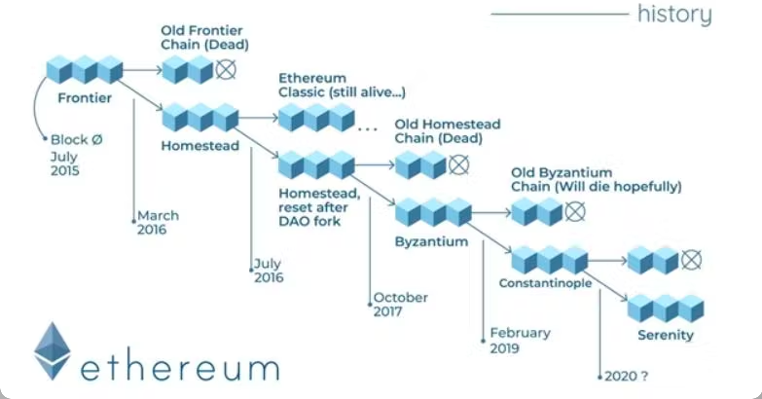
History of Ethereum (CO4)

Slide 24
Hard Fork (CO4)
Why is Fork?
Cryptocurrencies like Bitcoin and Ethereum are powered by decentralized, open-source software called a blockchain. A fork happens whenever a community makes a change to the blockchain’s protocol, or basic set of rules.
Cryptocurrencies like Bitcoin and Ethereum are powered by decentralized, open software that anyone can contribute to called a blockchain. They’re called blockchains because they’re literally made up of blocks of data – picture a really long train – that can be traced all the way back to the first-ever transaction on the network. And because they are open source, they rely on their communities to maintain and develop their underlying code.
A fork happens whenever a community makes a change to the blockchain’s protocol, or basic set of rules. When this happens, the chain splits — producing a second blockchain that shares all of its history with the original, but is headed off in a new direction.

Slide 25
Hard Fork (CO4)
Why is this important?
Most digital currencies have independent development teams responsible for changes and improvements to the network, much in the same way that changes to internet protocols allow web browsing to become better over time. So sometimes a fork happens to make a cryptocurrency more secure or add other features.
But it’s also possible for the developers of a new cryptocurrency to use a fork to create entire new coins and ecosystems.
Soft fork: Think of a soft fork as a software upgrade for the blockchain. As long as it’s adopted by all users, it becomes a currency’s new set of standards. Soft forks have been used to bring new features or functions, typically at the programming level, to both Bitcoin and Ethereum. Because the end result is a single blockchain, the changes are backward-compatible with the pre-fork blocks.
Hard fork: A hard fork happens when the code changes so much the new version is no longer backward-compatible with earlier blocks. In this scenario, the blockchain splits in two: the original blockchain and new version that follows the new set of rules. This creates an entirely new cryptocurrency – and is the source of many well-known coins. Cryptocurrencies like Bitcoin Cash and Bitcoin Gold evolved out of the original Bitcoin blockchain via hard fork.

Slide 26
Hard Fork (CO4)
What Is a Hard Fork?
Hard fork (or hardfork), as it relates to blockchain technology, is a radical change to a network's protocol that makes previously invalid blocks and transactions valid, or vice-versa. A hard fork requires all nodes or users to upgrade to the latest version of the protocol software.
Key Takeaways
A hard fork refers to a radical change to the protocol of a blockchain network that effectively results in two branches, one that follows the previous protocol and one that follows the new version.
In a hard fork, holders of tokens in the original blockchain will be granted tokens in the new fork as well, but miners must choose which blockchain to continue verifying.
A hard fork can occur in any blockchain, and not only Bitcoin (where hard forks have created Bitcoin Cash and Bitcoin SV, among several others, for example).

Slide 27
Hard Fork (CO4)
Hard Forks vs. Soft Forks?
Hard forks and soft forks are essentially the same in the sense that when a cryptocurrency platform's existing code is changed, an old version remains on the network while the new version is created.
With a soft fork, only one blockchain will remain valid as users adopt the update. Whereas with a hard fork, both the old and new blockchains exist side by side, which means that the software must be updated to work by the new rules. Both forks create a split, but a hard fork creates two blockchains and a soft fork is meant to result in one.
Considering the differences in security between hard and soft forks, almost all users and developers call for a hard fork, even when a soft fork seems like it could do the job. Overhauling the blocks in a blockchain requires a tremendous amount of computing power, but the privacy gained from a hard fork makes more sense than using a soft fork.

Slide 28
Architecture of Ethereum (CO4)
The Ethereum Foundation envisioned Ethereum as a decentralized computing platform that enables anyone to create, store, and run smart contract-based Decentralized Applications, or DApps.
Ethereum blockchain network is a decentralized Peer-to-Peer (P2P) network of Ethereum clients, representing network nodes. An Ethereum client refers to any node that can verify the new transaction, execute the smart contract, and process new blocks of the chain.
It is a kind of enclave, residing in thousands of computers or devices on the internet, and connected through the Ethereum P2P network.
What is enclaved is the Ethereum Virtual Machine or EVM and the runtime environment in the P2P network for smart contract execution.

Slide 29
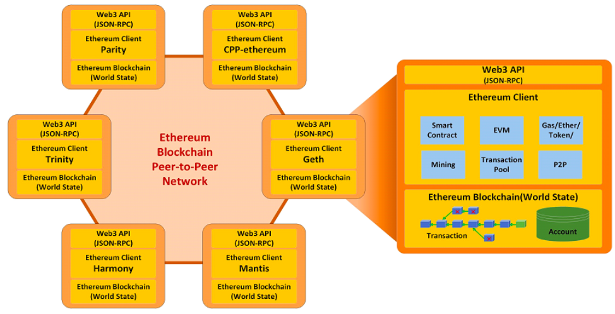
Architecture of Ethereum (CO4)

Slide 30
Architecture of Ethereum (CO4)
Ethereum clients run the EVM and can technically be written in any popular programming language. There are many different implementations of Ethereum clients.
Ethereum makes it possible for such a variety of different client implementations since every implementation has to conform to the protocol specification defined in the Ethereum Yellow Paper.
There are many advantages with such a variety of Ethereum client implementations, including the following:
It makes the network more resilient against bugs.
It prevents the centralization of developer resources.
In general, competitions between teams help to find the best solutions to common and challenging issues
Each client may have a different focus, strength, and weakness in mining, prototyping, DApp development, and more. DApp developers or private Ethereum blockchain operators may choose the ones fitting their own special needs.

Slide 31
Architecture of Ethereum (CO4)
Ethereum clients provide a set of web3 APIs over JSON-RPC for DApps interacting with an Ethereum blockchain. From your web or wallet application, you can use the web3 object provided by the web3.js library to communicate with the Ethereum network.
It works with any Ethereum client. Behind the scenes, it connects to a local or remote Ethereum node and makes RPC calls. In some sense, this is like the old client-server model, where DApps are the client, and the entire Ethereum network as a whole, acts as a server. To DApps, the Ethereum network is just like a giant world computer, assembled together with thousands of computing devices throughout the internet.
Once you connect to the network, you could connect to any node in the decentralized network. :

Slide 32
Architecture of Ethereum (CO4)
Beyond smart contracts and the EVM, an Ethereum client provides all blockchain components to maintain world state and state transitions in the blockchain network, including the following:
Managing transaction and state transition with the Ethereum blockchain
Maintaining world state and account state
Managing P2P communication Block finalization with mining
Managing transaction pool
Managing cryptoassets, gas, ether, and tokens
The design behind Ethereum, based on the whitepaper, is intended to build a simple, efficient and extensible blockchain platform, and have a Turing-complete program language to support more sophisticated and complex computations. It not only has all of the benefits of a blockchain but can serve as the framework for supporting all types of digital assets and value transfers as well.
diagram:

Slide 33
Ethereum Network (CO4)
Overview Of Ethereum Network :
Vitalik Buterin, a programmer, proposed Ethereum in 2013. The network went live in 2015, with an initial supply of 72 million coins, after being crowdfunded in 2014.
The Ethereum Virtual Machine (EVM) can run decentralized programs and execute scripts. Ethereum is used for decentralized banking, the production and distribution of non-fungible tokens (NFTs), and many ICOs.
After Bitcoin, Ethereum is quoted as the second most prevalent crypto-currency. Unlike Bitcoin, Ethereum is proposed to be much more than simply a means of exchange or a store of value.
Ethereum, on the other hand, refers to itself as a decentralized computer network based on blockchain technologies. Ethereum is built on top of a blockchain network. A blockchain is a transparent, distributed public ledger that verifies and records all transactions. Everyone on the Ethereum network has an exact copy of this ledger, which allows them to view all previous transactions.

Slide 34
Ethereum Network (CO4)
Overview Of Ethereum Network :
The Ethereum network allows users to build and run apps, smart contracts, and other transactions. These features are not available in Bitcoin.
It is only used as a medium of exchange and a store of cash. There is no boundary on how much Ether tokens can be produced while Bitcoin can only deliver 21 million coins.
All, regardless of context or location, have access to digital money and data-friendly resources thanks to Ethereum. It’s the technology that powers the ether (ETH) and thousands of other apps available today.
The Ethereum Virtual Machine (EVM) is run by Ethereum clients, which may be built in any popular programming language.

Slide 35
Ethereum Network (CO4)
Benefits of Ethereum client implementations
There are several benefits to having so many Ethereum client implementations, including the following as follows.
It strengthens the network’s bug resistance.
It keeps development resources from being centralized.
In general, team contests aid in the discovery of the best solutions to common and difficult problems.
In mining, prototyping, DApp development, and other areas, each customer may have a distinctive emphasis, strength, and weakness. DApp developers and private Ethereum blockchain operators may pick and choose which ones best suit their purposes.

Slide 36
Ethereum Network (CO4)
Components of Ethereum Network :
Component-1 Nodes – There are two types of nodes in an Ethereum network. They are as follows.
Mining Node – These nodes are responsible for writing all the transactions that have occurred in the Ethereum network in the block.
Ethereum Virtual Machine Node – These are the nodes in the Ethereum network in which Smart Contracts (it is a type of contract between supporter and developer in which there are a set of rules based on which both the parties agree to interact with each other. The agreement will be automatically executed when the pre-defined rules are met.) are implemented. By default, this node utilizes a 30303 port number for the purpose of communication among themselves.

Slide 37
Ethereum Network (CO4)
Components of Ethereum Network :
Component-2 Ether –
Ether is a type of cryptocurrency used in the Ethereum network just like a bitcoin is used in a blockchain network. It is a peer-to-peer currency, similar to Bitcoin.
It is the second-largest cryptocurrency in the world. The first one is Bitcoin. Other cryptocurrencies can be used to get ether tokens, but vice versa is not true.
It means that ether tokens can’t be interchanged by other cryptocurrencies to render computing power for Ethereum transactions. Ether is paid as a commission for any execution that affects the state in Ethereum.
It is used in the Ethereum algorithm as an incentive for miners who connect blocks to the blockchain using a proof-of-work method.
It is the only currency that can be used to pay transaction costs, which go to miners as well. The block reward, as well as transaction fees, provide miners with an opportunity to keep the blockchain rising.
Aside from paying for transactions, ether is often used to purchase gas, which is used to pay for the computation of any transaction on the Ethereum network.

Slide 38
Ethereum Network (CO4)
Components of Ethereum Network :
Component-3 Gas –
Gas is an internal currency of the Ethereum network. We need gas to run applications on the Ethereum network, much as we need gas to run a vehicle.
To complete every transaction on the Ethereum network, a consumer must first make a payment—send out ethers—and the intermediate monetary value is known as gas.
Gas is a unit of measurement on the Ethereum network for the computing power used to execute a smart contract or a transaction.
The price of gas is very low compared to Ether. The execution and resource utilization costs are predetermined in Ethereum in terms of Gas units, called gwei.

Slide 39
Ethereum Network (CO4)
Components of Ethereum Network :
Component-4 :
Ethereum Accounts – There are two types of Ethereum accounts. They are as follows.
Externally owned account – These accounts are used to store transactions.
Contract account – As the name itself suggests, these accounts store the details of Smart Contracts.

Slide 40
Ethereum Network (CO4)
Components of Ethereum Network :
Component-5 :
Nonce – For externally owned accounts, nonce means the number of transactions via this account. For a contract account, nonce means the number of contracts generated via this account.
Component-6 :
Storage Root – It is the main root node of a Merkle tree. Hash of all details of the account is stored here. The root of the Merkle tree is the verification of all transactions.
Component-7 :
Ethash – The intended PoW algorithm for Ethereum 1.0 is Ethash. It’s the most recent version of Dagger-Hashimoto, however, it’s no longer proper to call it that because many of the algorithms’ initial characteristics have been dramatically altered in the previous month of study and development. The original version may be found here.

Slide 41
Ethereum Virtual Machine (CO4)
Introduction to Ethereum Virtual Machine (EVM)
An EVM is the runtime environment that executes Ethereum smart contracts.
Ethereum contains its own Turing-complete scripting language, called Solidity, and with this comes a need to execute this code.
A program called the Ethereum Virtual Machine (EVM) can do this task.
It runs on top of the Ethereum network, meaning that all nodes reach a consensus about what code should be executed at every given time.

Slide 42
Ethereum Virtual Machine (CO4)
Purpose of EVM
It is the computer that stores data on blockchain, like bitcoin, but it also executes code in smart contracts on the Ethereum network.
The machine is made to be able to run any kind of Crypto-contract that can be built on Ethereum’s blockchain. It does this by using a programming language called Solidity, which is compiled into the EVM for execution.
The intention behind writing code on the Ethereum network is to create smart contracts and programs that automatically execute things when certain conditions are met. If a terms or condition is not met, the system can execute it in an “exit” function as well.
For example, if an account has been hacked, the hacker cannot steal money from the system, because they don’t have the budget or authority to do so.

Slide 43
Ethereum Virtual Machine (CO4)
How Does EVM Works?
Ethereum Virtual Machine (EVM) is a program which executes scripts used to implement certain operations usually in Ethereum blockchain. The Ethereum Virtual Machine makes the process of creating new tokens on Ethereum Blockchain easy. Here, script means a set of instructions or an algorithm which tells the computer what it needs to do in order for something to work properly. The EVM requires that one has access over any network node so as to be able to execute the desired commands and create new tokens on the blockchain without any difficulties.
In Ethereum, there is something called a smart contract. These contracts have some computer code which facilitates the exchange of money and information.
These contracts are predefined by the creator of the smart contract, in order to ensure that a certain outcome will happen based on either what happens or doesn’t happen.
Ethereum Virtual Machine provides Turing complete environment for execution of scripts and smart contracts. This means that anything that can be implemented with a computer can be run on EVM.
Ethereum Virtual Machine ensures that all transactions and smart contracts made on the Ethereum blockchain are executed in correct and expected manner as desired by the smart contract code. It serves as a platform for applications to be executed on.

Slide 44
Ethereum Virtual Machine (CO4)
How Does Gas Relate to Performance Of EVM?
Gas is a measure of computational power. It determines how much time each transaction and contract takes to execute.
Because there is so much code already in the system, it uses a limited amount of Gas to run all of this code. It sets the default gas limit to 250,000 gas units.
In general, the more complicated your transaction, the more gas it takes to execute.

Slide 45
Ethereum Virtual Machine (CO4)
Benefits of EVM
Execute untrusted code without risking data:
Can run complex smart contracts:
Deterministic processing:
Robust against failure:
Easy to write stateful contracts:

Slide 46
Ethereum Virtual Machine (CO4)
Downsides of EVM
High cost of storing data:
High gas cost:
High gas price during network congestion:
Technical expertise required:

Slide 47
ERC Standards (CO4)
What Are They?
In the Ethereum blockchain platform, ‘Ethereum Request for Comments (ERC) is a document that smart contract programmers use to write smart contracts. In these documents, Ethereum-based tokens are described as having to comply with certain rules.
The ultimate Ethereum guide is a good place to start if you’re unfamiliar with the fundamentals of Ethereum.
This process is called the Ethereum Improvement Proposal, and it is used by the Ethereum developer and community to review these documents. The developer who created the document might then revise it as a result of their comments.
After working through the EIP process, some of these documents are accepted by the Ethereum community, finalized, and then developers implement them. These documents are then called ERC tokens. Basically, ERCs originate as EIPs and can cover various areas, such as tokens, registration names, etc.

Slide 48
Application Application Development of Ethereum (CO4)
Ethereum Private Network
An Ethereum Private Network is a completely private Blockchain which is isolated from the Main Ethereum network. Ethereum Private Network is mainly created by organizations to restrict the read permissions of the Blockchain. Only the nodes with the right permissions will be able to access this Blockchain. The nodes in this network are not connected to the main network nodes and their reach is restricted only to this private Blockchain.
Why is Ethereum Private Network used?
Ethereum Private Network is used by organizations to store private data which should not be visible to people outside their organization. Ethereum Private Network is also used for testing and experimenting the Blockchain if someone doesn’t want to use the public test networks.

Slide 49
Application Application Development of Ethereum (CO4)
Features of Ethereum Private Network
It acts as a Distributed Database
Blockchain in the Ethereum Private Network can contain private data (because the network is not public)
Access can be permission-based
Making transactions can be free
Accounts can be allocated with ethers by ourselves which does not even require buying virtual ethers

Slide 50
Application Application Development of Ethereum (CO4)
Ethereum Test Network
Before a project launches on the Ethereum blockchain (or before changes are made to the blockchain itself), a version is deployed to an Ethereum Test Network (“testnet”), which simulates Ethereum — this gives developers, the community, and you a chance to kick the tires before real assets are involved.
Ether and tokens on a testnet are easy to obtain, and carry no real-world value — still, it can be fun to own 10,000 Ether or a trillion tokens on a testnet.
Testnets
There are three testnets currently in use, and each behaves similarly to the production blockchain (where your real Ether and tokens reside). Developers may have a personal preference or favorite testnet, and projects typically develop on only one of them.
Ropsten: A proof-of-work blockchain that most closely resembles Ethereum; you can easily mine faux-Ether.
Kovan: A proof-of-authority blockchain, started by the Parity team. Ether can’t be mined; it has to be requested.
Rinkeby: A proof-of-authority blockchain, started by the Geth team. Ether can’t be mined; it has to be requested.

Slide 51
Application Application Development of Ethereum (CO4)
Smart Contract
A Smart Contract (or cryptocontract) is a computer program that directly and automatically controls the transfer of digital assets between the parties under certain conditions. A smart contract works in the same way as a traditional contract while also automatically enforcing the contract.
The bitcoin network was the first to use some sort of smart contract by using them to transfer value from one person to another.
The smart contract involved employs basic conditions like checking if the amount of value to transfer is actually available in the sender account.
Later, the Ethereum platform emerged which was considered more powerful, precisely because the developers/programmers could make custom contracts in a Turing-complete language.
It is to be noted that the contracts written in the case of the bitcoin network were written in a Turing-incomplete language, restricting the potential of smart contracts implementation in the bitcoin network.
There are some common smart contract platforms like Ethereum, Solana, Polkadot, Hyperledger fabric, etc.

Slide 52
Application Application Development of Ethereum (CO4)
Features of Smart Contracts
Distributed:
Deterministic:
Immutable:
Autonomy:
Customizable:
Transparent:
Trustless:
Self-verifying:
Self-enforcing:

Slide 53
Application Application Development of Ethereum (CO4)
What is Smart Contract in Solidity?
Solidity’s code is encapsulated in contracts which means a contract in Solidity is a collection of code (its functions) and data (its state) that resides at a specific address on the Ethereum blockchain. A contract is a fundamental block of building an application on Ethereum.

Slide 54
Application Application Development of Ethereum (CO4)
Smart contract security and vulnerability.
SMART CONTRACTS VULNERABILITIES
Vulnerabilities in smart contracts are serious enough for several reasons:
Most of the smart contracts deal with financial assets.
Errors in smart contracts, once published, cannot be corrected due to the immutable nature of the blockchain.
Changes in blockchain’s state generated by transactions of faulty or fraudulent contracts cannot be rolled back.

Slide 55
Application Application Development of Ethereum (CO4)
Smart contract security and vulnerability.
SMART CONTRACT SECURITY ISSUES
INDIRECT EXECUTION OF UNKNOWN CODE
REENTRANCY
INCORRECT CALCULATION OF THE OUTPUT TOKEN AMOUNT
INTERFACE/NAMING ISSUES
DEPENDENCY ON THE ORDER OF EXECUTION
TIME COMPONENT
USING THE BLOCKHASH FUNCTION
INCORRECTLY HANDLED EXCEPTIONS
INCORRECT WORK WITH ERC20 TOKEN

Slide 56
Faculty Video Links, Youtube & NPTEL Video Links and Online Courses Details
Youtube/other Video Links
https://www.youtube.com/watch?v=SSo_EIwHSd4&vl=en
https://www.youtube.com/watch?v=RT7x0lQvSLk
https://www.youtube.com/watch?v=yubzJw0uiE4
https://www.khanacademy.org/economics-finance-domain/core-finance/money-and-banking/bitcoin/v/bitcoin-transaction-block-chains

Slide 57
Daily Quiz
Q:1 What is the smallest and largest denomination of Ethereum Units?
A) Finney & Ada
B) Sasha Grey & Rocco Siffredi
C)Wei & Tether
D) Einstein & Mether
Q2: Who is the founder of Ethereum?
A) Vitalik Buterin
B) Whoopi Goldberg
C) Max Kaiser
D) Mike o'Hearn
Q3: What is one major difference between Bitcoin and Ethereum?
A) Ethereum relies on Proof of Stake whilst Bitcoin relies on Proof of Work
B) Ethereum has a deflationary economic model and Bitcoin doesn’t
C) Ethereum is accepted by more merchants than Bitcoin
D) Ethereum's internal code is Turing Complete whilst Bitcoin's isn't

Slide 58
Daily Quiz
Q4: What is an Ether in Ethereum?
A) The main denomination used in Ethereum
B) A anaesthetic liquid used to knock people out
C) A name for the cloud computing process of Ethereum contracts
D) A method of redistributing Ethereum via mining
Q5: How many Ether's are issued per block in general?
A) 69 Ether
B) 20 Ether
C) 10 Ether
D) 5 Ether

Slide 59
Weekly Assignment
Q1: What Are the Real-World Use Cases of Ethereum?
Q2: What Is the Ethereum Network? Explain.
Q3: Explain How Proof-Of-Work (Pow) Works?
Q4: Tell Us About Smart Contract Use Cases?
Q5: What Are the Main Steps of Smart Contract Development from A Business Perspective?
Q6: What Are the Benefits of Having A Private Network?

Slide 60
MCQ s
Q1: What algorithm does Ethereum use for its Proof of Work?
A) CryptoNight B) Groestl
C) EtHash D) Scrypt
Q2: What is Ethereum?
A) A Bitcoin side chain
B) A Michelson-Morley Experiment
C) A distributed computer network with its own currency
D) A Litecoin clone at I
Q3: What is gas in Ethereum?
A) The cost of generating a correct block hash
B) A way of pricing transactions based on their computational complexity
C) A measurement of how many nodes are attached to the network
D) How much power the network has securing it in Giga Hashes

Slide 61
MCQ s(Cont….)
Q4: In which programming language is Smart Contracts written?
A) kotlin
B) tcl/tk
C) solidity
D) python
Q5: Which type of language is solidity?
A) procedure oriented language
B) object oriented language
C) scripting language
D) low level language

Slide 62
MCQ s(Cont….)
Q6: Which among the following statements are/is true? S1: Smart contract can interact with other smart contracts S2: Smart contract can call an API on the web
A) S1 only
B) S2 only
C) Both S1 and S2
D) Neither S1 nor S2
Q7: What does machines belonging to distributed system join to Ethereum network and validate transactions called?
A) blocking
B) mining
C) mist
D) chaining
Q8: Which among the following is Ethereum's native browser?
A) Mist
B) Block
C) Mime
D )Edge

Slide 63
MCQ s(Cont….)
Q9: What does Ethereum development involve/s?
A) networking
B) app hosting
C) databasing
D) All of the above
Q10: Ethereum is best suited for
A) economic systems
B) video creation systems
C) website creation
D) survey systems

Slide 64
MCQ s(Cont….)
Q11: Which among the feature does Ethereum ensures to provide?
A) decentralized storage
B) transparent governance for communities
C) zero-infrastructure platform
D) All of the above
Q12: Ether based own tokens can be launched on which Ethereum chains?
A) public chains only
B) private chains only
C) Both public and private chains
D) own tokens cant be generated
Q13: Which among the following is true with respect to all the transactions in EVM?
A) The transactions are recorded publicly
B) The transactions are secret by nature
C) Its difficult to trace the transactions from one account to another
D) Hashing is not performed for few transaction attributes

Slide 65
MCQ s(Cont….)
Q14: Why is EVM widely popular?
A) Its globally accessible
B) It’s a virtual machine
C) Access to EVM is easy as it requires either node or wallet
D All of the above
Q15: In case of Ethereum, the virtual machines are created with
A) hardware only
B) software only
C) both hardware and software
D) both hardware and firmware

Slide 66
MCQ s(Cont….)
Q16: Which among the following is true with respect to EVM?
A) It is designed for specific purposes
B) ownerless virtual machine
C) accepts any programming language
D) its licensed
Q17: As part of block processing protocol, every node on EVM is
A) highly parallel
B) highly centralized
C) highly redundant
D) highly sequential
Q18: What are EVM Applications commonly known as?
A) Transaction Applications
B) Transaction Contracts
C) Smart Contracts
D) Contract Applications

Slide 67
MCQ s(Cont….)
Q19: Which is true with respect to Solidity language?
A) high-level language
B) compiled into bytecode
C) uploaded to Ethereum blockchain
D) All of the above
Q20: Gas limit determines
A) how much computation can happen per block
B) how much storage can be allocated per block
C) Accounts for computational work
D) All of the above

Slide 68
Old Question Papers
NA

Slide 69
Expected Questions for University Exam
Q1: What is the Ethereum network?
Q2: Describe smart contracts on the Ethereum blockchain.
Q3: What’s the difference between Ethereum and Bitcoin?
Q4: Explain about EVM?
Q5: What are dApps?

Slide 70
Faculty Video Links, Youtube & NPTEL Video Links and Online Courses Details
My Video :
https://youtu.be/rPD97AZ9W2U
https://youtu.be/QbBHCehF3xo
https://youtu.be/JRlJPlbOP7I
Youtube/other Video Links
https://www.youtube.com/watch?v=yubzJw0uiE4
https://www.youtube.com/watch?v=_160oMzblY8
https://www.youtube.com/watch?v=YJyXfjbBmc8
https://www.youtube.com/watch?v=ENrjn-lD1e8

Slide 71
Glosarry Questions
Ethereum Network………….
EVM ...
What Is the Value Token for Ethereum ...
What Is the Consensus Algorithm………………….? ...
Which Consensus Algorithm Does Ethereum Use……………..?
What Are Smart Contracts……………………….?

Slide 72
Summary
Overview of Ethereum
Architecture Overview,
Ethereum Public/Private network,
Ethereum Test networks, Solidity,
Smart contract security and vulnerability.

Slide 73
References
1.AndreasM.AntonopoulosandGavinWood,“Mastering Ethereum:Building Smart Contracts and DApps”, O′Reilly 2.MelanieSwan,“Blockchain:Blueprint for a New Economy”, O′Reilly
3.MattZand, Xun(Brian)Wu, and MarkAnthon,“ Handson Smart Contract Development with Hyperledger FabricV2
4. Daniel Drescher, Block chain basics A non-technical introduction in 25 steps, Apress , 2017. Paul Vigna and Michael J.Casey.
5. The Age of Cryptocurrency, 2015. Supplementary Readings: Antonopoulos, Mastering Bitcoin : Unlocking Digital Cryptocurrencies.
6. Mastering Blockchain - Imar Bashir - Second edition - Packt - 2018. Satosh Nakamoto, Bitcoin : A peer-to-peer electronic Cash system.

Slide 74
Noida Institute of Engineering and Technology, Greater Noida
Thank You

